Slide 1




End-to-end HR Analytics
Presented by :
Daniya Ghooshal
Hiresight
Python · MySQL · Power BI

Slide 2


The Hiring Problem
Hiring performance is often judged by volume and speed
Cost-per-hire alone ignores retention and employee quality
High early attrition leads to hidden long-term costs

Slide 3



Cost efficiency
90-day retention
Project Objective
Quality of hire

Slide 4


Data & Tech Stack
PYTHON
MYSQL
POWER BI
Synthetic HR dataset generated using Python
KPIs and analytics built in Power BI using DAX
Data cleaned and modeled in MySQL

Slide 5
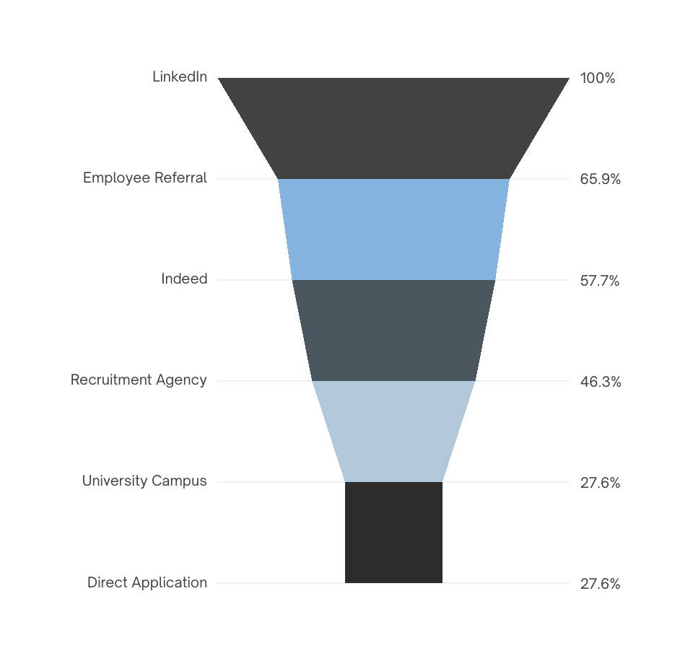
Hiring Funnel Performance
High application volume does not translate to retention
Only ~65–70% of applications convert to offers
Early attrition (first 90 days) varies sharply by source
High application volume does not guarantee stable hires quality gaps emerge early in the funnel.

Slide 6
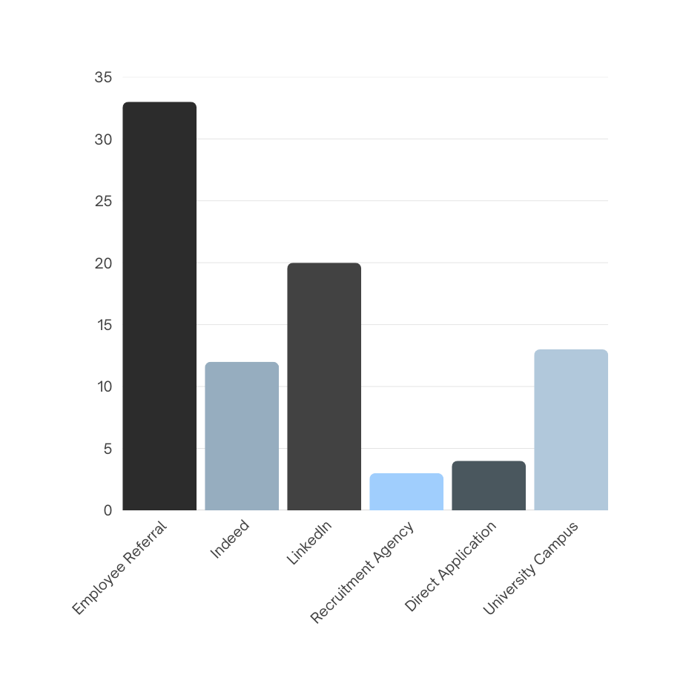
QUALITY OF HIRE
Referral hires show ~1.3–1.5× higher quality scores
Agency hires underperform despite higher cost
University hiring shows strong quality but mixed retention
Quality of hire varies more by source than by hiring volume.

Slide 7


Salford
23
Insights
Avg Cost per Hire
Avg Tenure in Months
₹3.6K
Retention < 75% → early warning
Quality of Hire < 60% → source needs review
Cost must be evaluated per retained employee
Cost per Hire
21.3%
400
Quality of Hire
Total Hires

Slide 8

So What?
Problem
Analysis
Impact
Action
Volume Driven Hiring
ROI & quality metrics
Lower attrition; better talent
Budget reallocation

Slide 9


Thank You
Portfolio
for your time and attention
Contact me

